Slide 1


QUICKSTOCK
POS & Inventory Management
Technology Used in Small Businesses
System Analysis & Design
Submitted to:
Raihan Kibria Senior Lecturer Department of Computer Science and Engineering (CSE)
Course: CSE3103
Presented By:
Raju Ahammed (242014131)
Md. Iftekharul Alam Sikder (241014054)
Nasrin Sultana Muskan (241014019)
Nayem hasan (242014196)

Slide 2
INTRODUCTION
What is QuickStock?
QuickStock is a modern Point of Sale (POS) and Inventory Management System designed to digitalize and streamline daily operations for small retail businesses in Bangladesh.

Slide 3
Problem & Solution
The Problem
The Solution
• Manual billing
• Stock-outs & overstock
• Slow checkout
• No sales insights
• Fast POS + barcode scanning
• Real-time inventory alerts
• < 2 sec checkout
• Smart analytics
02
QuickStock

Slide 4
System Overview
POS and Inventory Management System designed for small retail businesses in Bangladesh with real-time inventory tracking using barcode scanning technology.
Automated billing and invoicing with sales analytics and reporting. Features low-stock alerts, cloud-based multi-user support, and fast transaction processing under 2 seconds.
03
QuickStock

Slide 5
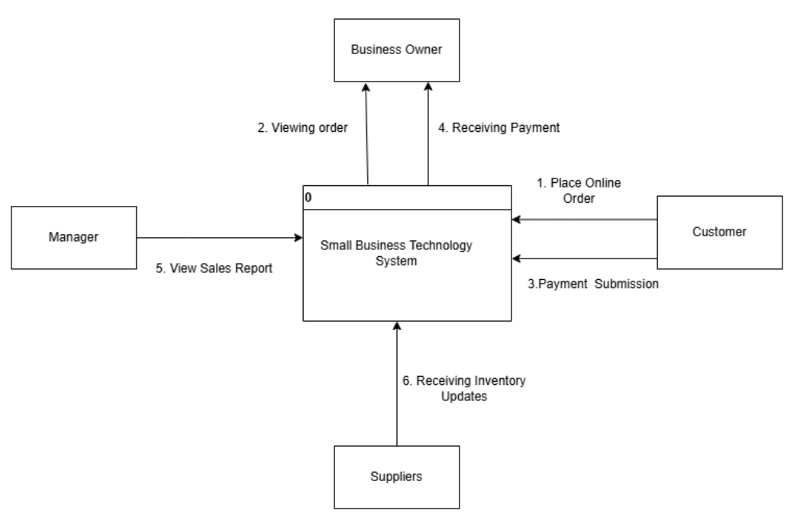
Context Diagram
04
QuickStock

Slide 6
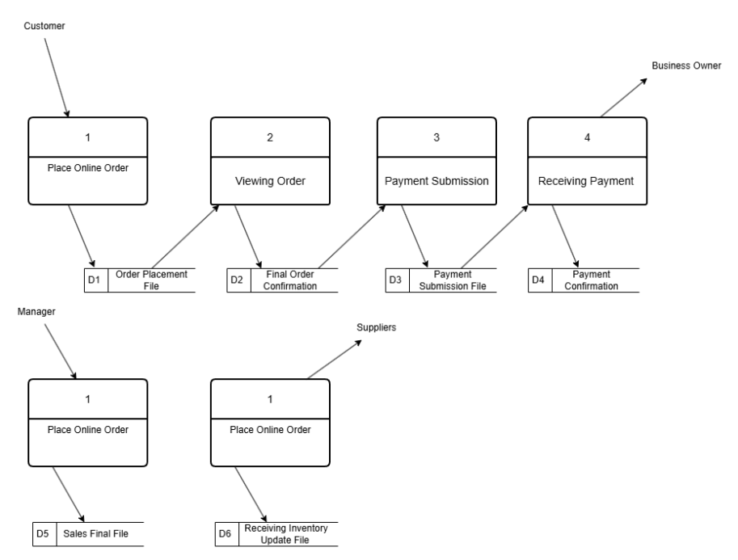
Data Flow Diagram (DFD Level 0)
05
QuickStock POS

Slide 7
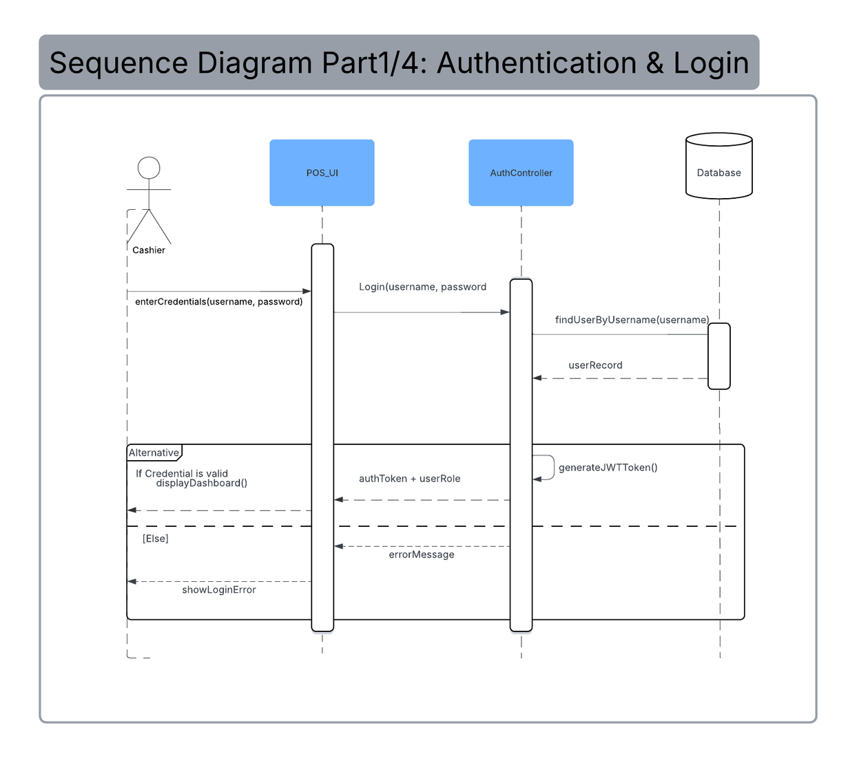
Sequence Diagram
06
QuickStock POS

Slide 8
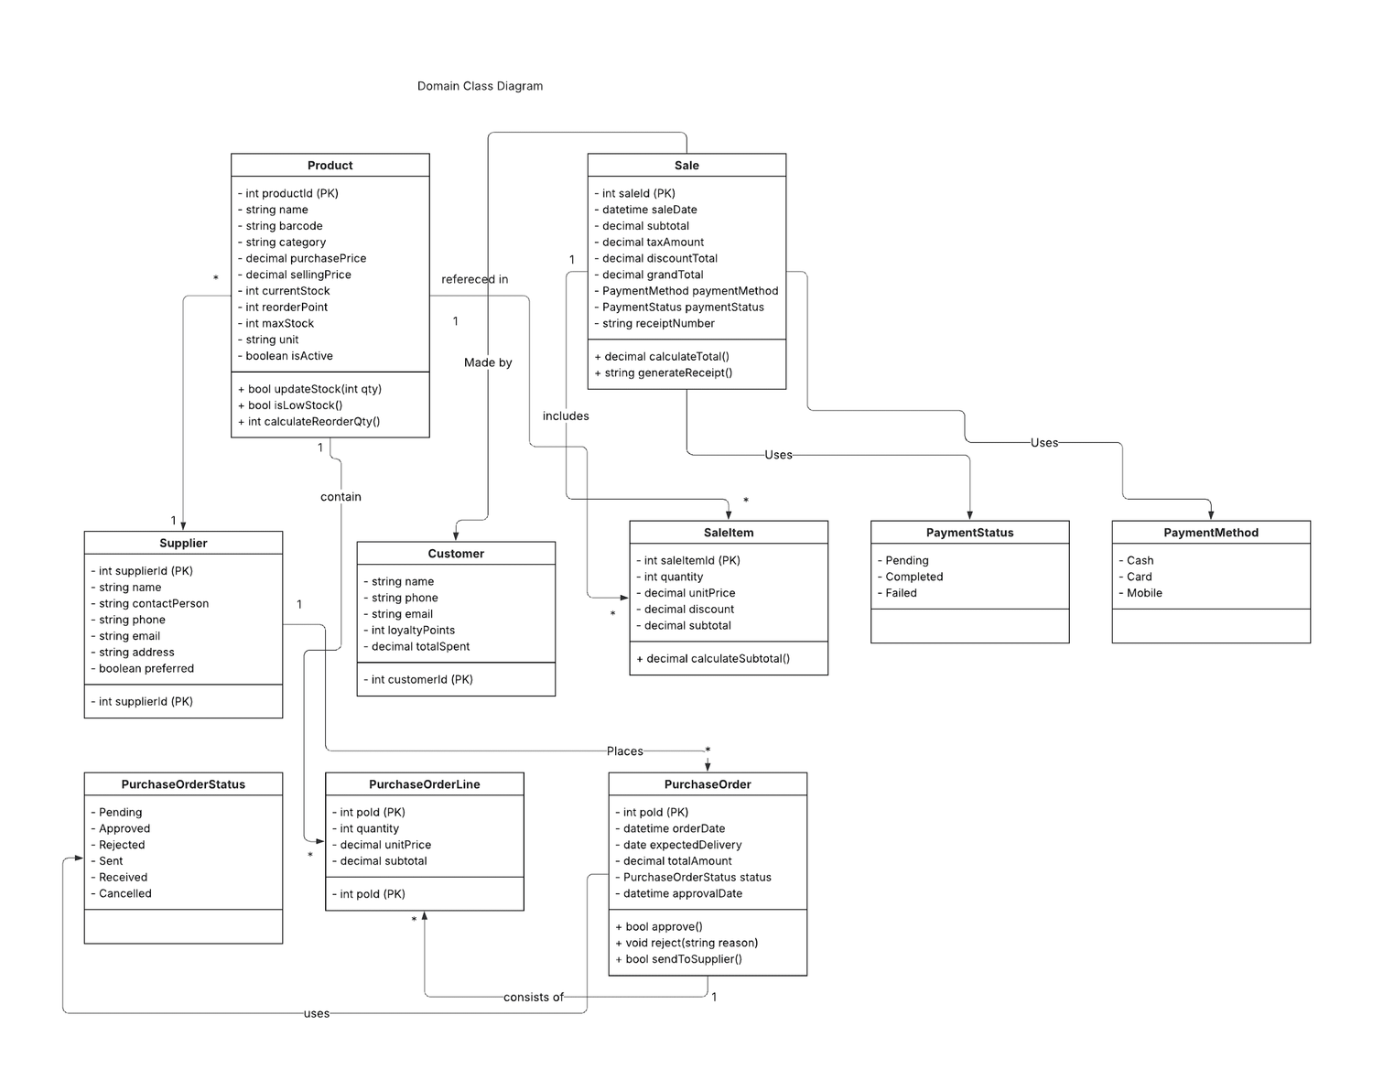
Class Diagram
07
QuickStock POS

Slide 9
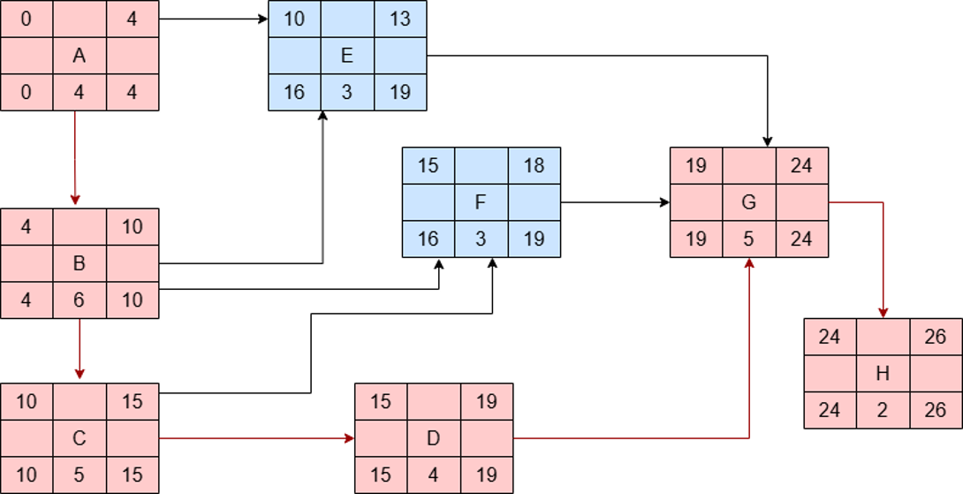
Critical Path Analysis
08
QuickStock POS

Slide 10
Key Features & Benefits
Key Features
Benefits
• Barcode scanning for fast checkout
• Real-time inventory tracking
• Automated low-stock alerts
• Sales analytics dashboard
• Multi-user access control
• Cloud backup and security
• Reduced checkout time (under 2 seconds)
• Prevent stock-outs and overstock
• Data-driven decision making
• Improved customer experience
• Reduced manual errors
• Scalable for business growth
09
QuickStock

Slide 11
Conclusion
Provides fast transaction processing for efficient checkout
Enables real-time inventory tracking to monitor stock instantly
Offers automated analytics tailored for small retail businesses in Bangladesh
Supports barcode scanning for quick and accurate product handling
Includes low-stock alerts to prevent inventory shortages
Uses cloud-based architecture for reliability and accessibility
Reduces checkout time and improves customer experience
Helps prevent stock management issues
Supports data-driven decision making
Promotes sustainable business growth
10
QuickStock POS

Slide 12
Thank You
Feel Free to Ask Any Questions

